Slide 1
Smartwatch Data Analysis

Slide 2
DATASETS USED
01 The 1st dataset is a fitness tracker product dataset consisting of different products from various brands with their specifications, ratings, and reviews for the Indian market. The data was collected from an e-commerce website (Flipkart).
02 The 2nd dataset consists of different features that are present in the smartwatch with their respective index values.

Slide 3
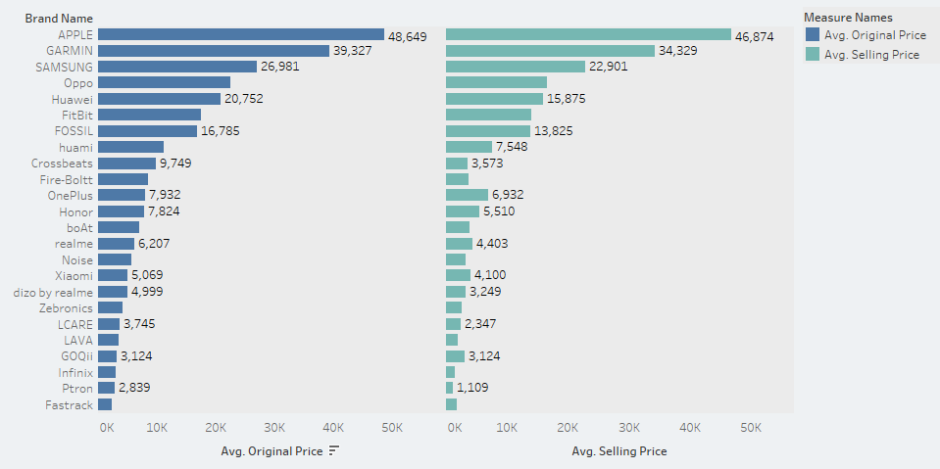
Average cost and selling price of smartwatches

Slide 4
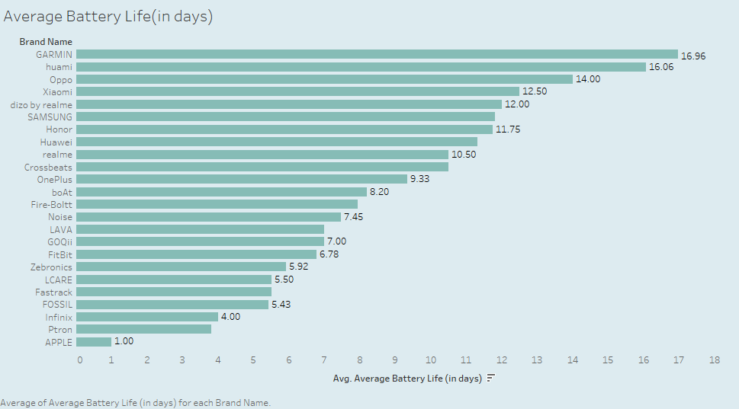
Average Battery Life (in days)

Slide 5
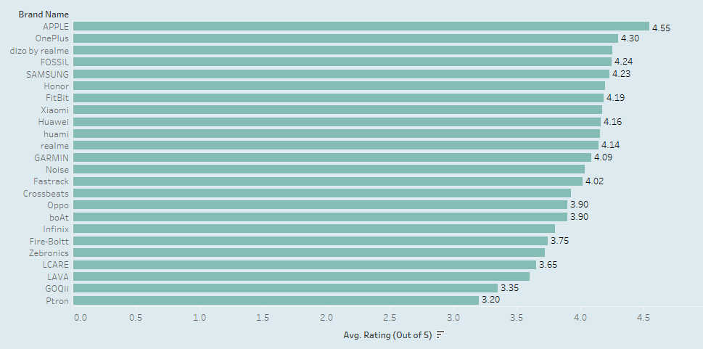
Smartwatches with the average rating out of 5

Slide 6
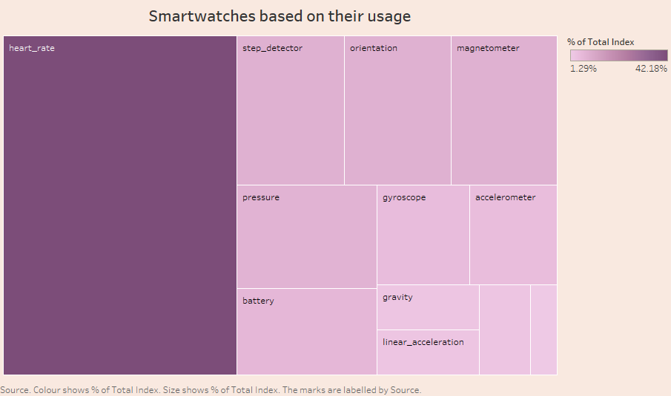
Most used features in Smartwatches

Slide 7
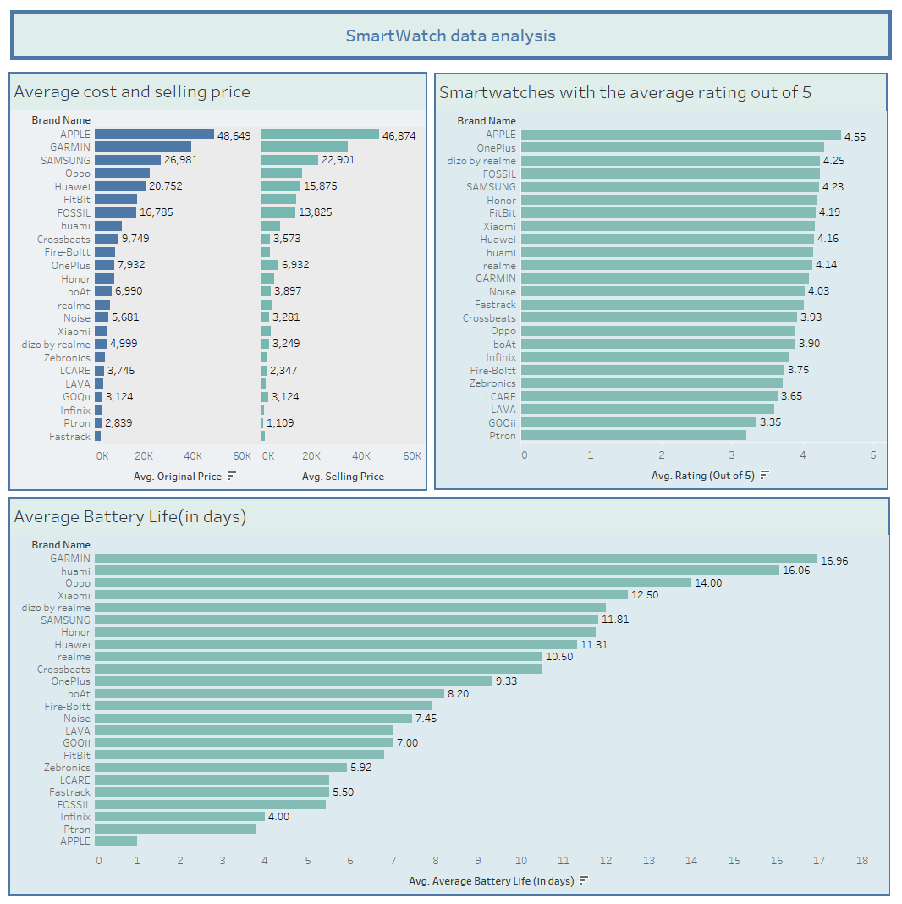

Slide 8
SUMMARY
After Analyzing the 1st dataset, it can stated that dizo by realme smartwatches are the most reliable smartwatch among the other brands having a good battery
life, average rating and comes in affordable price.
After dizo by realme smartwatches, Samsung comes in the 2nd most reliable smartwatch among the other brands.
After Analyzing the 2nd dataset, we encounter that the heart rate monitor is the most used
feature (42.18 %) in smartwatches, followed by the step detector (8.52%) and orientation
(8.47%).

Slide 9
THANK YOU

